Slide 1

Multivariate Plot Types
Notes:
constant challenge

Slide 2
The Problem
Represent data with more than two dimensions in a two-dimensional medium.
Notes:
3+D data → 2D medium.
We don't all have a 3D analysis environment

Slide 3
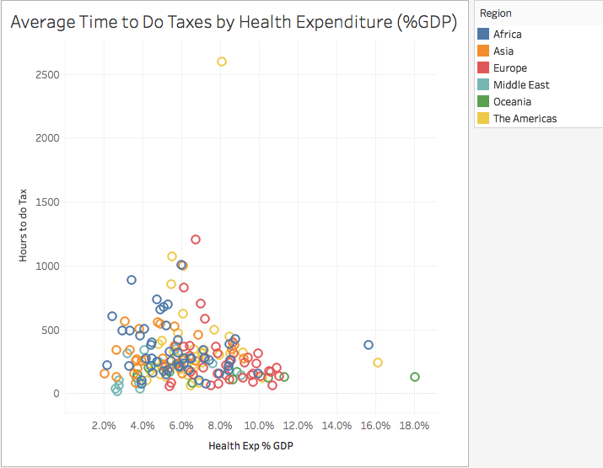
Notes:
treating marks specially, shape, color, size, etc.

Slide 4
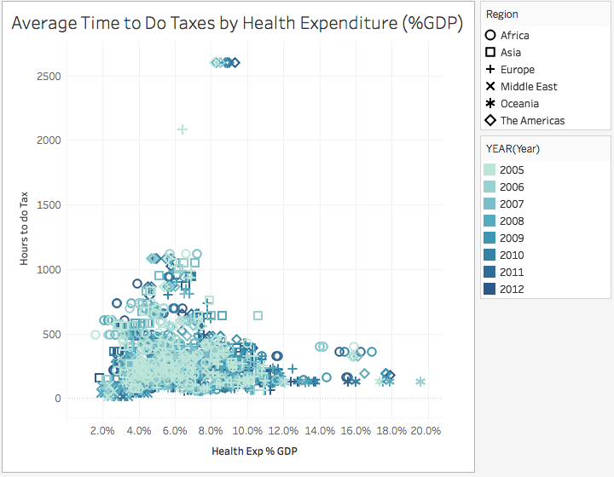
Notes:
Adding shape to color.
Making the user work.

Slide 5
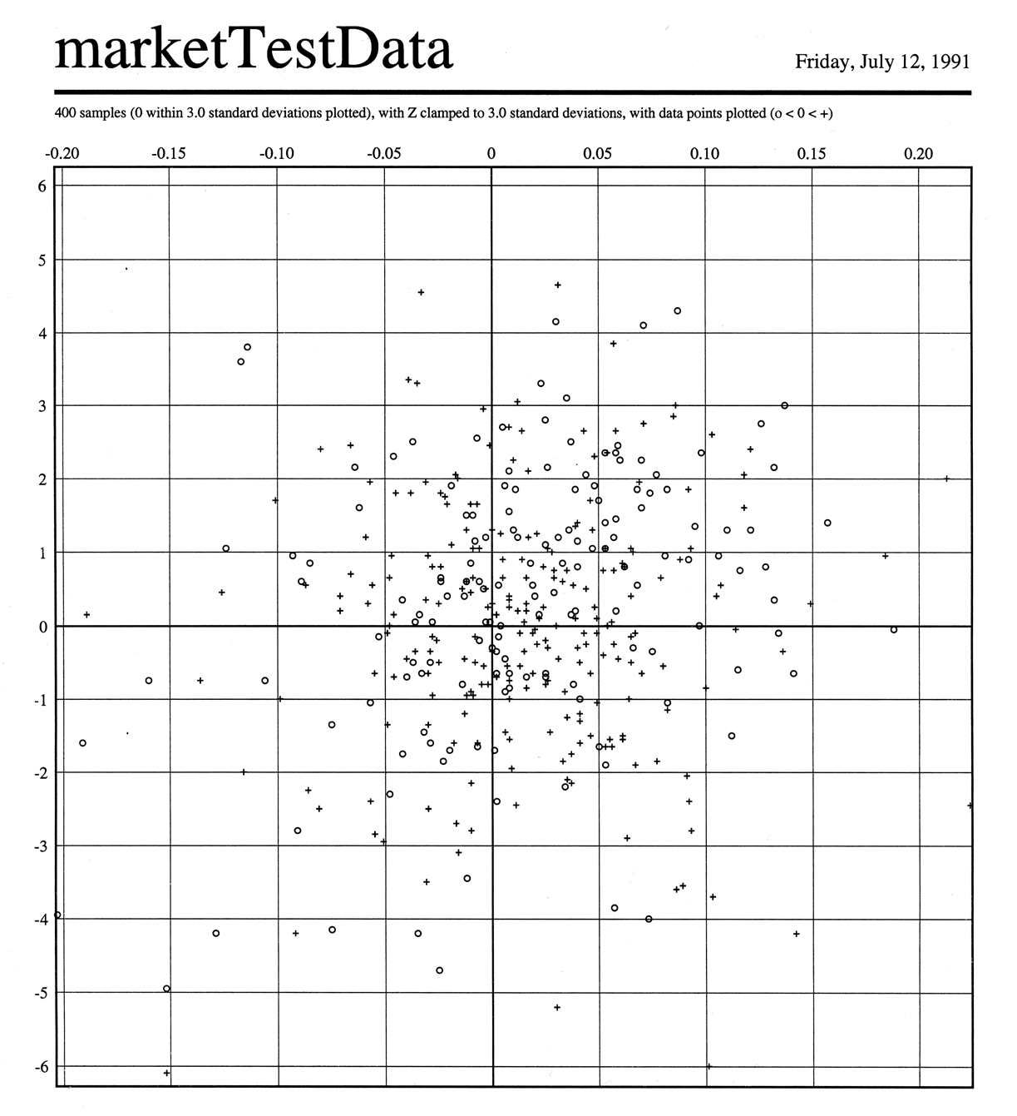
W. Bradford Paley, http://wbpaley.com/brad/chartingAndGraphicWork.html
Notes:
Interesting case study - W. Bradford Paley, 1991.
Tried + and o for positive and negative results.
Using lightness instead of shape
Applied a gaussian blur

Slide 6
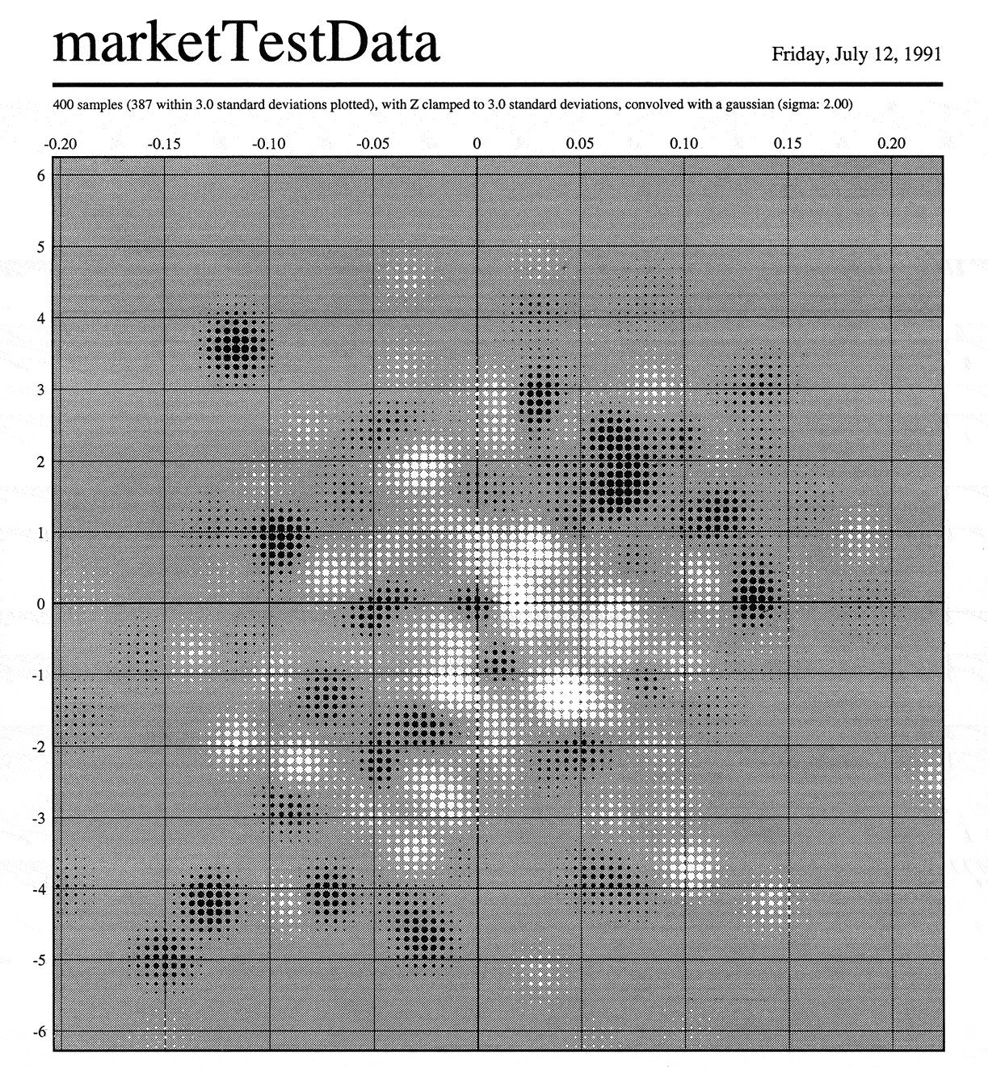
W. Bradford Paley, http://wbpaley.com/brad/chartingAndGraphicWork.html

Slide 7
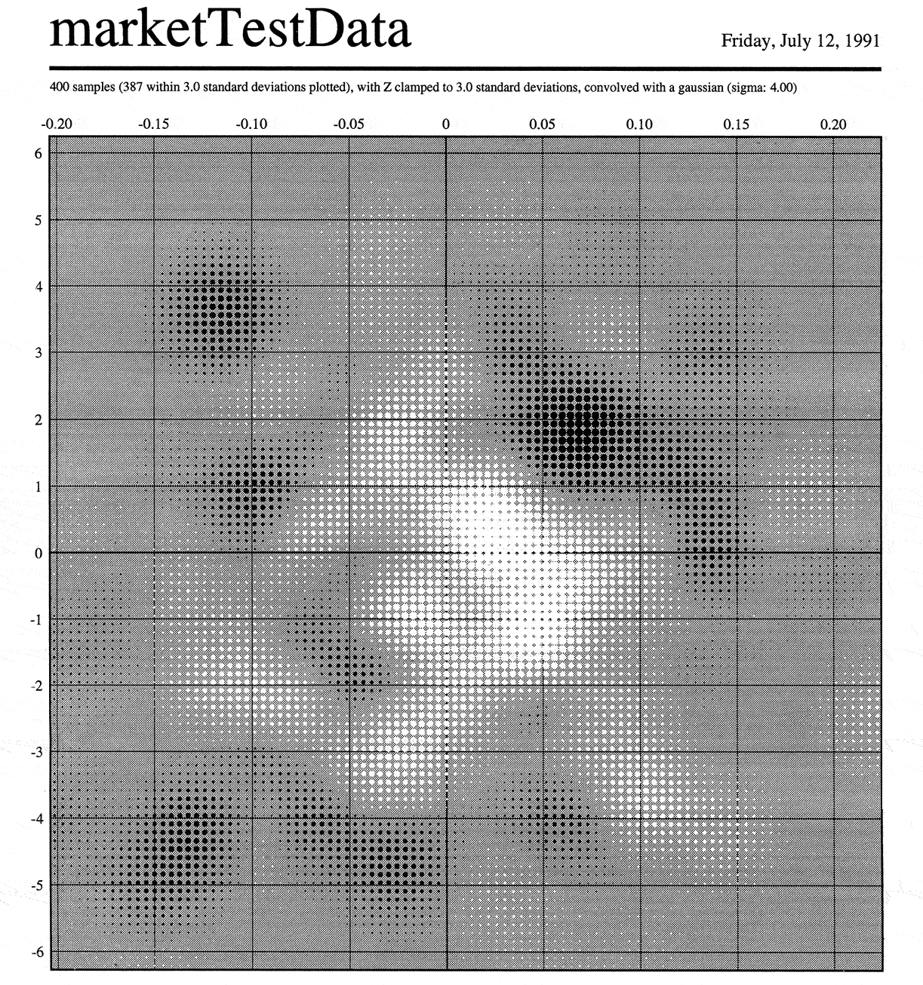
W. Bradford Paley, http://wbpaley.com/brad/chartingAndGraphicWork.html
Notes:
More blur shows patterns

Slide 8
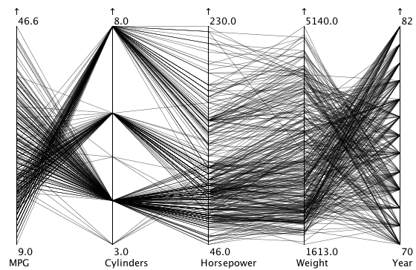
Notes:
Parallel coordinates
Works pretty well, takes some effort
Each vertical line = an axis for a different dimension.
You can see groupings, like the number of cylinders clustering around 4,6, and 8. 8 cylinder cars have a wide range of horsepower.
secret weapon: interaction.

Slide 9
Notes:
select individual lines
move the axes around

Slide 10
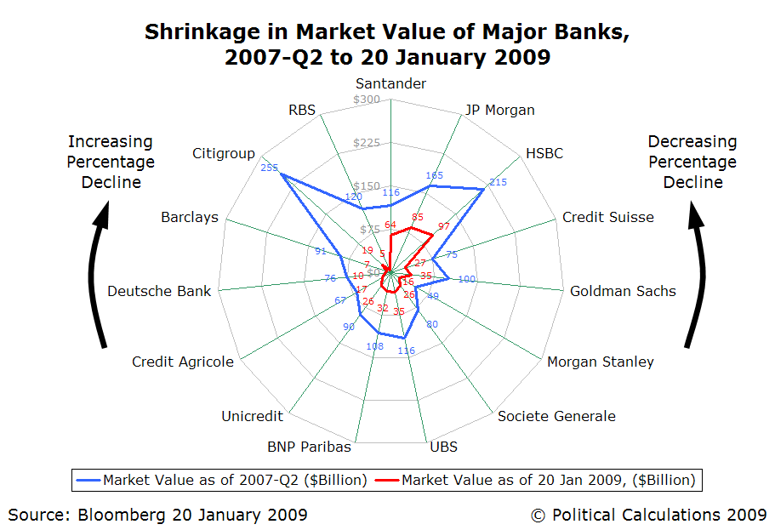
Notes:
Radar plots, spider plots,
like a parallel coords graph bent into a circle.
Hard to compare across circle, occlusion
They're a little better when they have fewer lines plotted.
bad example - encodes quantitative data circularly

Slide 11
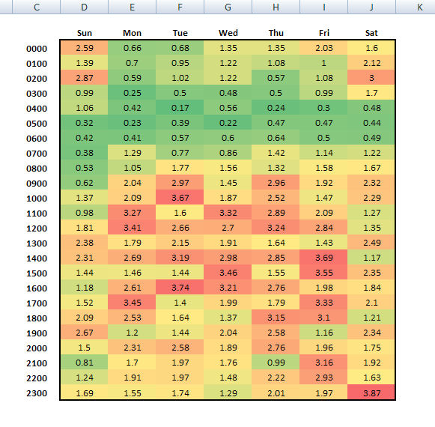
PoliceAnalyst.com
Notes:
Heatmaps – natural for categoricalx categorical x quant

Slide 12
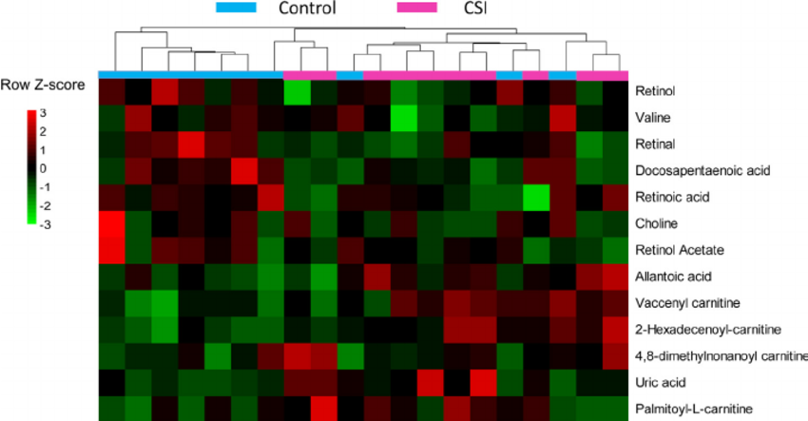
Feng et al., “Chronical sleep interruption-induced cognitive decline assessed by a metabolomics method,” Behavioral Brain Research, 302 (2015)
Notes:
column dendrogram for hierarchical clustering
Bar adds color coding for dendrogram branches
Some color clash

Slide 13
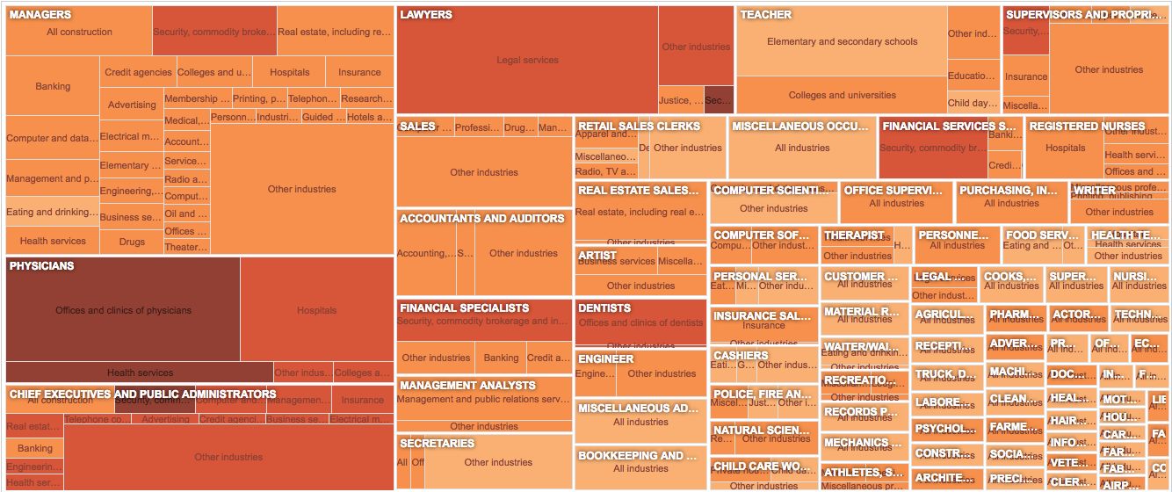
The New York Times
Notes:
Treemap – another hierarchical vis
Size
Color
Nesting for relationships

Slide 14
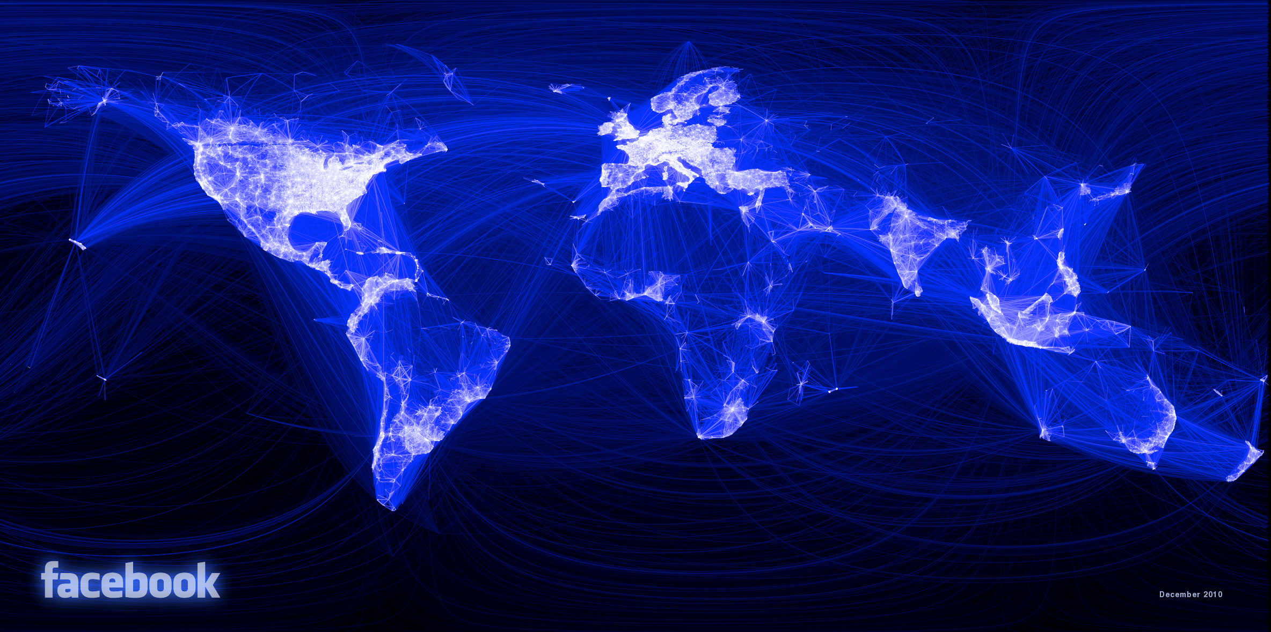
Notes:
Another way to show relationships: node and link x lat long

Slide 15
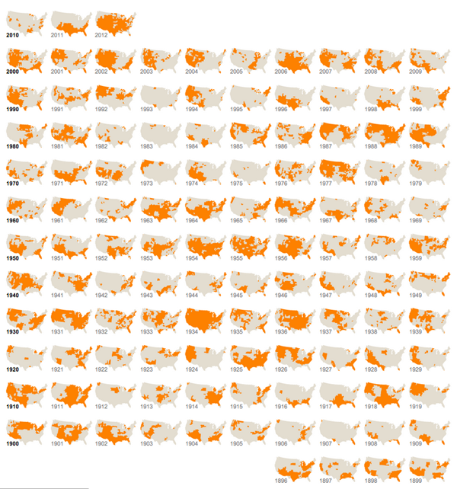
Notes:
Extra dimension in any kind of graph
Tufte
Small is still useful

Slide 16
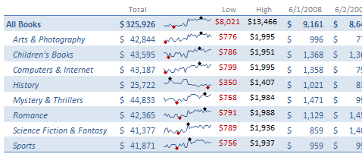
Notes:
Sparklines – another Tufte favorite
kind of small multiple
Small is good
Min and max shown with dot

Slide 17
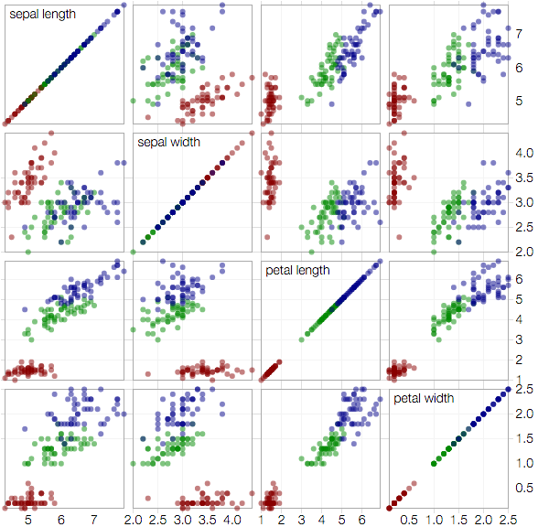
Notes:
Scatterplot matrix
Another kind of small multiple
Quant x quant x cat/quant

Slide 18
Which Is Best?
Depends on the data
Notes:
depends on the shape of your data.
Data types, comparisons needed (tasks)

Slide 19


